Slide 1
P R E S E N T A T I O N
2 0 2 6
Student Name
Samrin Seraj
Student Email
Samrinseraj3 @gmail.com
Mentor Name
Umamaheswari

Slide 2

Outline
Abstract of the Project
Problem Statement
Proposed Solution
System Architecture
Live Demo of the Project
Embedded Video of Project
Conclusion
Future Scope

Slide 3


Abstract
This project presents an analysis of Blinkit grocery sales data using Power BI to understand business performance and customer trends. The main objective of the project is to analyse sales patterns, product performance, and outlet efficiency to support better decision-making. The project uses tools and technologies such as Power BI for data visualisation, Power Query for data cleaning, DAX for calculations, and ChatGPT for generating insights and summaries. The dataset was processed and transformed to ensure accuracy and consistency before analysis.
The expected outcome of this project is to provide clear insights into key metrics like total sales, average sales, product demand, and customer ratings. These insights help in identifying high-performing products and improving business strategies.
A key highlight of this project is the creation of an interactive and user-friendly dashboard, combined with the use of ChatGPT to quickly generate insights and enhance the overall analysis process.

Slide 4

Problem Statement
This project addresses the problem of analysing large and complex sales data in retail businesses like Blinkit. It is difficult to identify trends, product performance, and customer behaviour without proper tools.
This problem is important because it directly affects sales, business decisions, and overall efficiency. It mainly impacts business owners, analysts, and retail companies.
Existing methods, like manual analysis or basic tools, are time-consuming and do not provide clear insights.
This project focuses on analysing sales data using Power
BI and generating insights with ChatGPT, without using real-time systems or advanced machine learning.

Slide 5

Proposed Solution
The proposed solution is to develop an interactive Power BI dashboard to analyse Blinkit grocery sales data and generate meaningful insights. This approach solves the problem by converting raw and complex data into clear visualisations that are easy to understand.
The methodology includes data cleaning using Power Query, data analysis using DAX, and dashboard creation using Power BI. ChatGPT is used to generate insights and summaries from the analysed data.
The key benefits of this solution are faster analysis, better visualisation, and improved decision-making. Compared to traditional methods, this approach is more efficient, user-friendly, and provides accurate insights in less time.

Slide 6



System Architecture
The data is collected from a Blinkit grocery dataset in Excel/CSV format, containing details such as item type, fat content, outlet size, location, sales, and ratings.
The data is cleaned and transformed using Power Query to fix inconsistencies and ensure accuracy. Analysis is performed using DAX to create KPIs like total sales, average sales, and ratings.
ChatGPT is used to generate insights, summaries, and explanations from the analysed data, helping in faster understanding and decision-making.
The final output is an interactive Power BI dashboard with charts and visualisations that display sales trends, product performance, and outlet analysis for better business insights.

Slide 7
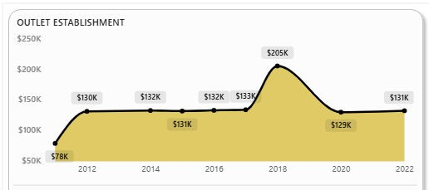
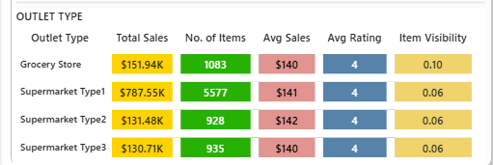
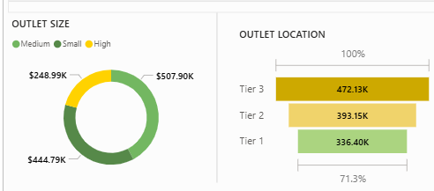

Live Demo of Project
Here's the list of some demo screenshots/features of the project:
Demo 1
This demo shows the trend of This demo shows the trend outlet establishment sales over the years, highlighting peak performance and growth patterns.
It helps identify the year with highest
sales and provides insights for better business planning and expansion.
Demo 2
This demo shows sales by outlet size and location.
It highlights that Tier 3 and medium outlets generate the highest revenue.
Demo 3
This demo shows sales performance across different product categories and fat content.
It helps identify high-selling categories and supports better product and inventory planning.

Slide 8



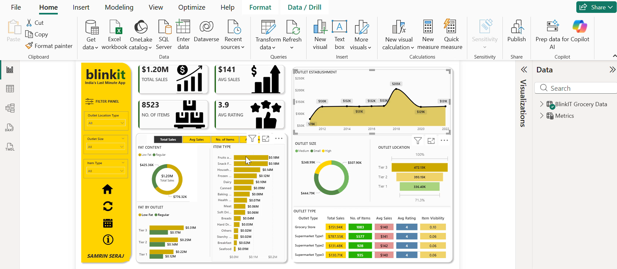
▶
Video of Project Demo
https://drive.google.com/file/d/1KwbeOf2Kby4XhdJe10FmzNI-MKW80Rbs/view?usp=sharing
[Insert your project demo video.
You can embed a video your live project.]

Slide 9

Conclusion
This project focused on analysing Blinkit grocery sales data using Power BI and ChatGPT. The data was cleaned and transformed, and important KPIs like total sales, average sales, number of items, and ratings were created. An interactive dashboard was developed to clearly visualise sales trends, product performance, and outlet analysis.
The key findings showed that some product categories generate higher sales, and outlet size and location play an important role in revenue. These insights help in understanding business performance more clearly.
All the objectives of the project were successfully achieved, including data cleaning, analysis, visualisation, and insight
generation.
Overall, this project adds value by helping businesses make better decisions, improve sales strategies, and use data analytics and AI tools effectively in real-world retail scenarios.

Slide 10

Future Scope
In the future, this project can be improved by adding real-time data integration so that the dashboard can show live updates and more accurate insights. This will help businesses monitor performance continuously.
Machine learning techniques can be applied for demand forecasting and better inventory planning, which can further improve decision-making.
The dashboard can also be integrated with e- commerce platforms and databases for automatic data updates. Additional features like alert systems for low sales or performance changes can be added. Overall, these improvements will make the system more advanced, scalable, and useful for real-world business applications.

Slide 11
Thank You
A I C W F e l l o w s h i p | S t u d e n t P r o j e c t P r e s e n t a t i o n 2 0 2 6
LinkedIn | Edunet Foundation

